Slide 1



IETF-101 Hackathon for I2NSF Framework
March 17-18, 2018
London in England
Jaehoon Paul Jeong
pauljeong@skku.edu

Slide 2
Introduction (1/3)
Goals at IETF-101 I2NSF Hackathon
The Support of RESTCONF for Consumer-Facing Interface according to the lastest Consumer-Facing Interface YANG Data Model.
Dynamic Selection for NSFs at Security Controller according to high-level security policy delivered via Consumer-Facing Interface.
SFC Support using OpenDaylight?'s OVS SFC Implementation for SFC-based Traffic Steering according to I2NSF Capabilities Information Model.

Slide 3
Introduction (2/3)
Working Group Drafts
​https://tools.ietf.org/html/rfc8192
​https://tools.ietf.org/html/rfc8329
​https://tools.ietf.org/html/draft-ietf-i2nsf-applicability-02
​https://tools.ietf.org/html/draft-ietf-i2nsf-capability-00
​https://tools.ietf.org/html/draft-ietf-i2nsf-nsf-facing-interface-dm-00
​https://tools.ietf.org/html/draft-ietf-i2nsf-consumer-facing-interface-dm-00
​https://tools.ietf.org/html/draft-kumar-i2nsf-client-facing-interface-im-05
​https://tools.ietf.org/html/draft-hares-i2nsf-capability-data-model-06
​https://tools.ietf.org/html/draft-hyun-i2nsf-nsf-triggered-steering-05
​https://tools.ietf.org/html/draft-hyun-i2nsf-registration-interface-im-04
​https://tools.ietf.org/html/draft-hyun-i2nsf-registration-interface-dm-03
​https://tools.ietf.org/html/draft-zhang-i2nsf-info-model-monitoring-05
​https://tools.ietf.org/html/draft-hong-i2nsf-nsf-monitoring-data-model-02

Slide 4
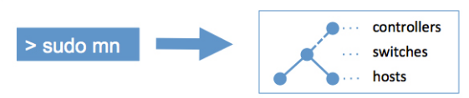






Introduction (3/3)
Build Environment
OS
  Ubuntu 14.04TL
Netconfd
  6.2 Version
Apache2
  2.4.7 Version
MySQL
  14.14 Version
PHP
  5.5.9 Version
Mininet
  2.2.1 Version
OpenDaylight
  Distribution-karaf-0.4.3-Beryllium-SR3
Suricata
  3.2.1 RELEASE
XSLT (Extensible StyleSheet Languages Transformations)
  xsltproc

Slide 5

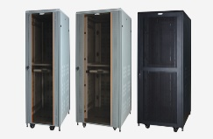



Network Configuration for Hackathon
I2NSF User
Security Controller
NSF1
(Firewall)
SFF
NSF2
(Web Filter)
Internet
Gateway
(NAT)
SDN Controller
Host
10.0.0.1
(Employee)
Switch
Switch
Switch
Switch
Switch
Switch
Enterprise Network

Slide 6
Policy Configuration (1/10)
Enterprise Mode
  Configuration of Security Level in Enterprise Network
    Security Level 1 (Wide Service Permission)
      File Service: FTP
      Connection Service: SSH, Telnet
      Mail Service: SMTP, POP2, POP3, IMAP4
      Web Service: HTTP, HTTPS
    Security Level 2 (Narrow Service Permission)
      Connection Service: SSH
      Mail Service: POP2, POP3, IMAP4
      Web Service: HTTPS
    Security Level 3: All Service Block (Intranet)

Slide 7
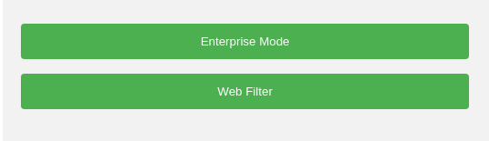
Policy Configuration (2/10)

Slide 8
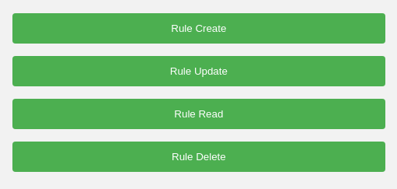
Policy Configuration (3/10)

Slide 9
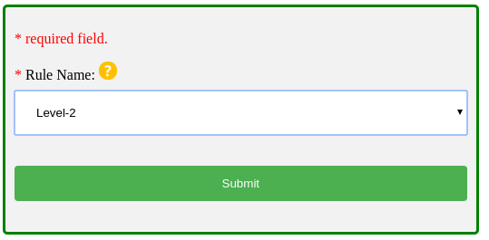
Policy Configuration (4/10)
I2NSF Consumer (Web)
High-Level ▶Low-Level
(Level-2)
▼
(port numbers 22, 109, 110, 143, 443, pass)
Security Controller

Slide 10
Policy Configuration (4/10)
I2NSF Consumer (Web)
Listen
High-Level ▶Low-Level
(Level-2)
▼
(port numbers 22, 109, 110, 143, 443, pass)
Security Controller

Slide 11
Policy Configuration (4/10)
I2NSF Consumer (Web)
Listen
High-Level ▶Low-Level
(Level-2)
▼
(port numbers 22, 109, 110, 143, 443, pass)
Security Controller

Slide 12
Policy Configuration (4/10)
I2NSF Consumer (Web)
RESTCONF/
YANG
1
High-Level Policy
Listen
High-Level ▶Low-Level
(Level-2)
▼
(port numbers 22, 109, 110, 143, 443, pass)
Security Controller

Slide 13
Policy Configuration (4/10)
I2NSF Consumer (Web)
RESTCONF/
YANG
1
High-Level Policy
Listen
High-Level ▶Low-Level
(Level-2)
▼
(port numbers 22, 109, 110, 143, 443, pass)
Security Controller
Extensible Stylesheet Language Transformations (XSLT)

Slide 14
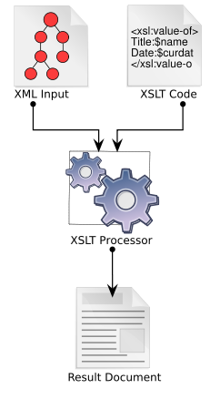
Policy Configuration (4/10)
XSLT (Extensible Stylesheet Language Transformations)

Slide 15
Policy Configuration (4/10)
XSLT (Extensible Stylesheet Language Transformations)
High-level
Policy
XSLT Stylesheet
Security Controller
Low-level
Policy

Slide 16
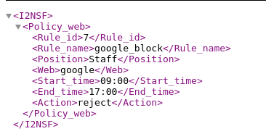
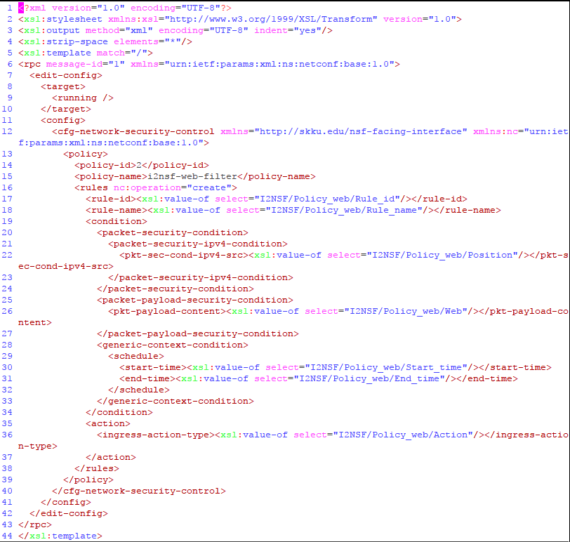
Policy Configuration (4/10)
XSLT (Extensible Stylesheet Language Transformations)
High-level
Policy
XSLT Stylesheet
Security Controller
Low-level
Policy

Slide 17
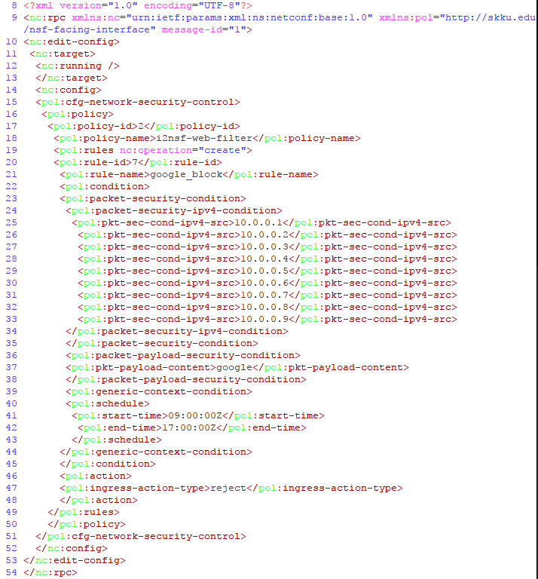
Policy Configuration (4/10)
XSLT (Extensible Stylesheet Language Transformations)
High-level
Policy
XSLT Stylesheet
Security Controller
Low-level
Policy

Slide 18




Policy Configuration (5/10)
Listen
High-Level ▶Low-Level
(Level-2)
▼
(port numbers 22, 109, 110, 143, 443, pass)
Security Controller
Firewall
Security Function Forwarder
Web Filter
Security Functions
Switch Controller
Switch₁
Switch₂
Switch₃

Slide 19
Policy Configuration (5/10)
Listen
High-Level ▶Low-Level
(Level-2)
▼
(port numbers 22, 109, 110, 143, 443, pass)
Security Controller
Extensible Stylesheet Language Transformations (XSLT)
Firewall
Security Function Forwarder
Web Filter
Security Functions
Switch Controller
Switch₁
Switch₂
Switch₃

Slide 20
Policy Configuration (5/10)
Listen
High-Level ▶Low-Level
(Level-2)
▼
(port numbers 22, 109, 110, 143, 443, pass)
Security Controller
Extensible Stylesheet Language Transformations (XSLT)
Firewall
Security Function Forwarder
Web Filter
Security Functions
Switch Controller
Switch₁
Switch₂
Switch₃

Slide 21
Policy Configuration (5/10)
Listen
High-Level ▶Low-Level
(Level-2)
▼
(port numbers 22, 109, 110, 143, 443, pass)
Security Controller
Extensible Stylesheet Language Transformations (XSLT)
NETCONF/
YANG
Firewall
Security Function Forwarder
Web Filter
Security Functions
Switch Controller
Switch₁
Switch₂
Switch₃

Slide 22
Policy Configuration (5/10)
Listen
High-Level ▶Low-Level
(Level-2)
▼
(port numbers 22, 109, 110, 143, 443, pass)
Security Controller
Extensible Stylesheet Language Transformations (XSLT)
NETCONF/
YANG
Firewall
Security Function Forwarder
Web Filter
Security Functions
Valid packets
Switch Controller
Invalid packets
Switch₁
Switch₂
Incoming packets
Switch₃

Slide 23
Policy Configuration (5/10)
Listen
High-Level ▶Low-Level
(Level-2)
▼
(port numbers 22, 109, 110, 143, 443, pass)
Security Controller
Extensible Stylesheet Language Transformations (XSLT)
NETCONF/
YANG
Firewall
Security Function Forwarder
Web Filter
Security Functions
Valid packets
Switch Controller
Invalid packets
Switch₁
Switch₂
Incoming packets
Switch₃

Slide 24
Policy Configuration (5/10)
Listen
High-Level ▶Low-Level
(Level-2)
▼
(port numbers 22, 109, 110, 143, 443, pass)
Security Controller
Extensible Stylesheet Language Transformations (XSLT)
NETCONF/
YANG
Firewall
Security Function Forwarder
Web Filter
Security Functions
Valid packets
Switch Controller
Invalid packets
Switch₁
Switch₂
Incoming packets
Switch₃

Slide 25
Policy Configuration (5/10)
Listen
High-Level ▶Low-Level
(Level-2)
▼
(port numbers 22, 109, 110, 143, 443, pass)
Security Controller
Extensible Stylesheet Language Transformations (XSLT)
NETCONF/
YANG
Firewall
Security Function Forwarder
Web Filter
Security Functions
Valid packets
Switch Controller
Invalid packets
Switch₁
Switch₂
Incoming packets
Outgoing packets
Switch₃

Slide 26
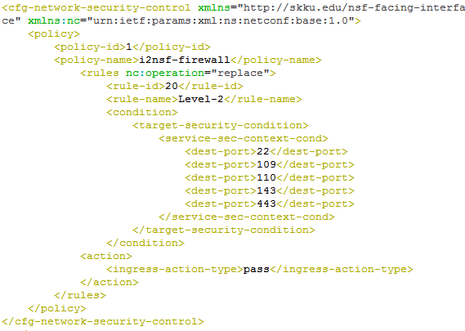
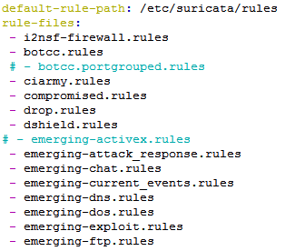

Policy Configuration (6/10)
Security Controller
Security Controller
High-Level
▼
Low-Level
Firewall
(Suricata)
Notes:
Slide 26 : Implementation Policy Configuration
The following is a Security Controller.
Number 1. Security Controller matched the data is imported via the Position Database and Web Database.
Number 2. Security Controller translates High-Level the data from the I2NSF Client (Web) into Low-Level using XSLT.
Number 3. The low-level xml for YANG structure is changed to Suricata rules

Slide 27
Policy Configuration (6/10)
Security Controller
Security Controller
High-Level
▼
Low-Level
https://tools.ietf.org/html/draft-kim-i2nsf-nsf-facing-interface-data-model-02
1
NETCONF/YANG
Firewall
(Suricata)
Notes:
Slide 26 : Implementation Policy Configuration
The following is a Security Controller.
Number 1. Security Controller matched the data is imported via the Position Database and Web Database.
Number 2. Security Controller translates High-Level the data from the I2NSF Client (Web) into Low-Level using XSLT.
Number 3. The low-level xml for YANG structure is changed to Suricata rules

Slide 28
Policy Configuration (6/10)
Security Controller
Security Controller
High-Level
▼
Low-Level
https://tools.ietf.org/html/draft-kim-i2nsf-nsf-facing-interface-data-model-02
1
NETCONF/YANG
Firewall
(Suricata)
Notes:
Slide 26 : Implementation Policy Configuration
The following is a Security Controller.
Number 1. Security Controller matched the data is imported via the Position Database and Web Database.
Number 2. Security Controller translates High-Level the data from the I2NSF Client (Web) into Low-Level using XSLT.
Number 3. The low-level xml for YANG structure is changed to Suricata rules

Slide 29
Policy Configuration (6/10)
Security Controller
Security Controller
High-Level
▼
Low-Level
https://tools.ietf.org/html/draft-kim-i2nsf-nsf-facing-interface-data-model-02
1
NETCONF/YANG
Firewall
(Suricata)
/etc/suricata/rules/i2nsf-firewall.rules
/etc/suricata/suricata_firewall.yaml
Notes:
Slide 26 : Implementation Policy Configuration
The following is a Security Controller.
Number 1. Security Controller matched the data is imported via the Position Database and Web Database.
Number 2. Security Controller translates High-Level the data from the I2NSF Client (Web) into Low-Level using XSLT.
Number 3. The low-level xml for YANG structure is changed to Suricata rules

Slide 30
Policy Configuration (7/10)
Web Filter
  Web Filter in Enterprise Network
  Web Filter using Content of Website in Packet Payload.
  Web Filter according to Position and Time

Slide 31
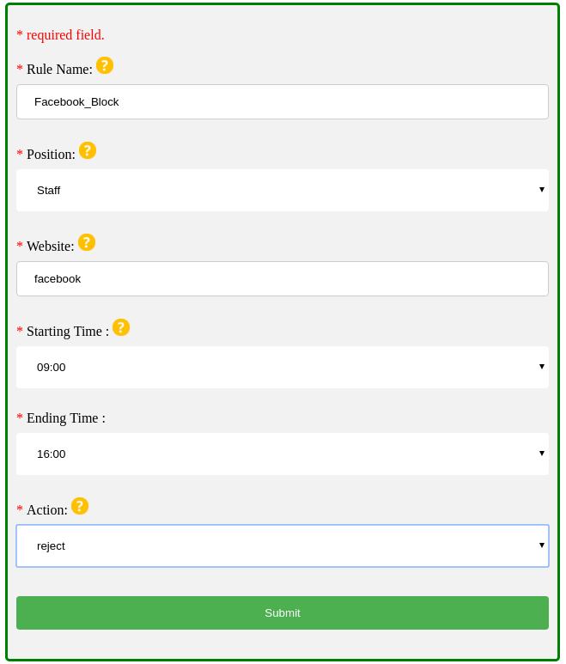
Policy Configuration (8/10)
I2NSF Consumer (Web)
Security Controller
High-Level ▶Low-Level
(Staff-Facebook-Block, Staff, Facebook, 09:00, 18:00, Reject)
▼
(Staff-Facebook-Block, 10.0.0.2, facebook, 09, 18, reject)

Slide 32
Policy Configuration (8/10)
I2NSF Consumer (Web)
Listen
Security Controller
High-Level ▶Low-Level
(Staff-Facebook-Block, Staff, Facebook, 09:00, 18:00, Reject)
▼
(Staff-Facebook-Block, 10.0.0.2, facebook, 09, 18, reject)

Slide 33
Policy Configuration (8/10)
Type a website for filtering
I2NSF Consumer (Web)
Select an action for the policy
Listen
Security Controller
High-Level ▶Low-Level
(Staff-Facebook-Block, Staff, Facebook, 09:00, 18:00, Reject)
▼
(Staff-Facebook-Block, 10.0.0.2, facebook, 09, 18, reject)

Slide 34
Policy Configuration (8/10)
Type a website for filtering
I2NSF Consumer (Web)
Select an action for the policy
RESTCONF/
YANG
1
High Level Policy
Listen
Security Controller
High-Level ▶Low-Level
(Staff-Facebook-Block, Staff, Facebook, 09:00, 18:00, Reject)
▼
(Staff-Facebook-Block, 10.0.0.2, facebook, 09, 18, reject)

Slide 35
Policy Configuration (8/10)
Type a website for filtering
I2NSF Consumer (Web)
Select an action for the policy
RESTCONF/
YANG
1
High Level Policy
Listen
Security Controller
High-Level ▶Low-Level
(Staff-Facebook-Block, Staff, Facebook, 09:00, 18:00, Reject)
▼
(Staff-Facebook-Block, 10.0.0.2, facebook, 09, 18, reject)
Extensible Stylesheet Language Transformations (XSLT)

Slide 36
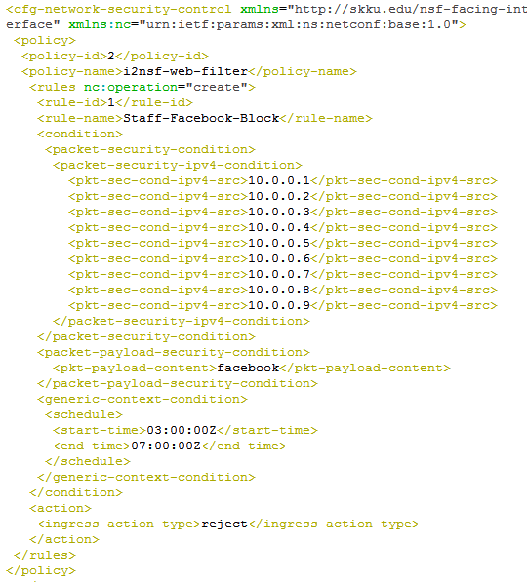
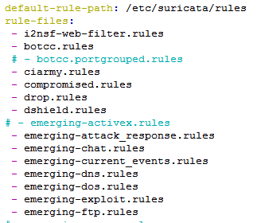

Policy Configuration (10/10)
Security Controller
Security Controller
High-Level
▼
Low-Level
Web Filter
(Suricata)
Notes:
Slide 26 : Implementation of Policy Configuration
The following is a Security Controller.
Number 1. Security Controller matched the data is imported via the Position Database and Web Database.
Number 2. Security Controller translates High-Level the data from the I2NSF Client (Web) into Low-Level using XSLT.
Number 3. The low-level xml for YANG structure is changed to Suricata rules

Slide 37
Policy Configuration (10/10)
Security Controller
Security Controller
High-Level
▼
Low-Level
https://tools.ietf.org/html/draft-kim-i2nsf-nsf-facing-interface-data-model-02
1
NETCONF/YANG
Web Filter
(Suricata)
Notes:
Slide 26 : Implementation of Policy Configuration
The following is a Security Controller.
Number 1. Security Controller matched the data is imported via the Position Database and Web Database.
Number 2. Security Controller translates High-Level the data from the I2NSF Client (Web) into Low-Level using XSLT.
Number 3. The low-level xml for YANG structure is changed to Suricata rules

Slide 38
Policy Configuration (10/10)
Security Controller
Security Controller
High-Level
▼
Low-Level
https://tools.ietf.org/html/draft-kim-i2nsf-nsf-facing-interface-data-model-02
1
NETCONF/YANG
Web Filter
(Suricata)
Notes:
Slide 26 : Implementation of Policy Configuration
The following is a Security Controller.
Number 1. Security Controller matched the data is imported via the Position Database and Web Database.
Number 2. Security Controller translates High-Level the data from the I2NSF Client (Web) into Low-Level using XSLT.
Number 3. The low-level xml for YANG structure is changed to Suricata rules

Slide 39
Policy Configuration (10/10)
Security Controller
Security Controller
High-Level
▼
Low-Level
https://tools.ietf.org/html/draft-kim-i2nsf-nsf-facing-interface-data-model-02
1
NETCONF/YANG
Web Filter
(Suricata)
/etc/suricata/i2nsf-web-filter.rules
/etc/suricata/suricata.yaml
Notes:
Slide 26 : Implementation of Policy Configuration
The following is a Security Controller.
Number 1. Security Controller matched the data is imported via the Position Database and Web Database.
Number 2. Security Controller translates High-Level the data from the I2NSF Client (Web) into Low-Level using XSLT.
Number 3. The low-level xml for YANG structure is changed to Suricata rules

Slide 40

Enterprise Network with I2NSF Framework
Network Security Functions (NSF) -Triggered Steering
Security Controller
Link ( )
High-Level ▶Low-Level
(Level-2)
▼
(22, 109, 110, 143, 443, pass)
Policy
Mininet
Topology
Packet(Host2->SFF)
Packet(SFF->FW)
Service Function Forwarder
(Classifier)
Client
(Host)
Switch Controller
Switch
Host
10.0.0.2
Cloud for NSFs
Switch
Host
10.0.0.3
Internet
Server
(Web Site)
www.Facebook.com
Notes:
Slide 27 : Implementation of Packet Flow
The following is a Network Security Functions (NSF) configuring the set Switch Controller, Security Controller, Security Funcion Forwarder, Switch and Host in Mininet Topology.
Host was composed of Cloud for NSFs, Client and Web Site Server.

Slide 41
Firewall for HTTP Packet Blocking
Network Security Functions (NSF) -Triggered Steering
Security Controller
Link ( )
High-Level ▶Low-Level
(Level-2)
▼
(22, 109, 110, 143, 443, pass)
Case of Enterprise-Mode
Policy
Mininet
Topology
Packet(Host2->SFF)
Packet(SFF->FW)
Cloud for NSFs
HTTP Packet Block
Service Function Forwarder
(Classifier)
Host Packet Forwarding (Firewall)
Client
(Host)
Switch Controller
Block
Firewall
Switch
Host
10.0.0.2
Web Filter
Switch
Host
10.0.0.3
DDoS-attack mitigation
Internet
VoIP/VoLTE
Server
(Web Site)
www.facebook.com
Notes:
Slide 28 : Implementation of Packet Flow
Number 1. The policy is forwarded from Security Controller to Firewall, So the policy on the Firewall is entered.
Number 2. In attempts to connect Host 2 to Facebook.
Number 3. The packet is transmitted for connect.
Number 4. By default, The packet via the Switch Controller, is sent to the Security Function Forwarder (SFF).
Number 5. Security Function Forwarder (SFF) is looking to the packet sent to the Firewall.
Number 6. However, since the input Firewall policy to the packet it is to be Block.
This implementation is considered to be able to be useful in various companies and organizations.

Slide 42
Web Filter for Packet Content Blocking
Network Security Functions (NSF) -Triggered Steering
Security Controller
Link ( )
High-Level ▶Low-Level
(Staff-Facebook-Block, Staff, Facebook, 09:00, 18:00, Reject)
▼
(Staff-Facebook-Block, 10.0.0.2, facebook, 09, 18, reject)
Case Web Filter
Policy
Mininet
Topology
Packet(Host2->SFF)
Packet(SFF->FW)
Packet Content Block
(e.g., facebook)
Cloud for NSFs
Service Function Forwarder
(Classifier)
Host Packet Chaining
(Firewall -> Web Filter)
Client
(Host)
Switch Controller
Steering
Firewall
Switch
Host
10.0.0.2
Block
Web Filter
Switch
Host
10.0.0.3
DDoS-attack mitigation
Internet
VoIP/VoLTE
Server
(Web Site)
www.facebook.com
Notes:
Slide 28 : Implementation of Packet Flow
Number 1. The policy is forwarded from Security Controller to Firewall, So the policy on the Firewall is entered.
Number 2. In attempts to connect Host 2 to Facebook.
Number 3. The packet is transmitted for connect.
Number 4. By default, The packet via the Switch Controller, is sent to the Security Function Forwarder (SFF).
Number 5. Security Function Forwarder (SFF) is looking to the packet sent to the Firewall.
Number 6. However, since the input Firewall policy to the packet it is to be Block.
This implementation is considered to be able to be useful in various companies and organizations.

Slide 43
Information of I2NSF Hackathon Project
Github for I2NSF Hackathon and YouTube for Video Demonstration
Documents and Source Code
https://github.com/kimjinyong/i2nsf-framework
YouTube Videoclip
https://www.youtube.com/watch?v=fRCnQX2aFa4

Slide 44
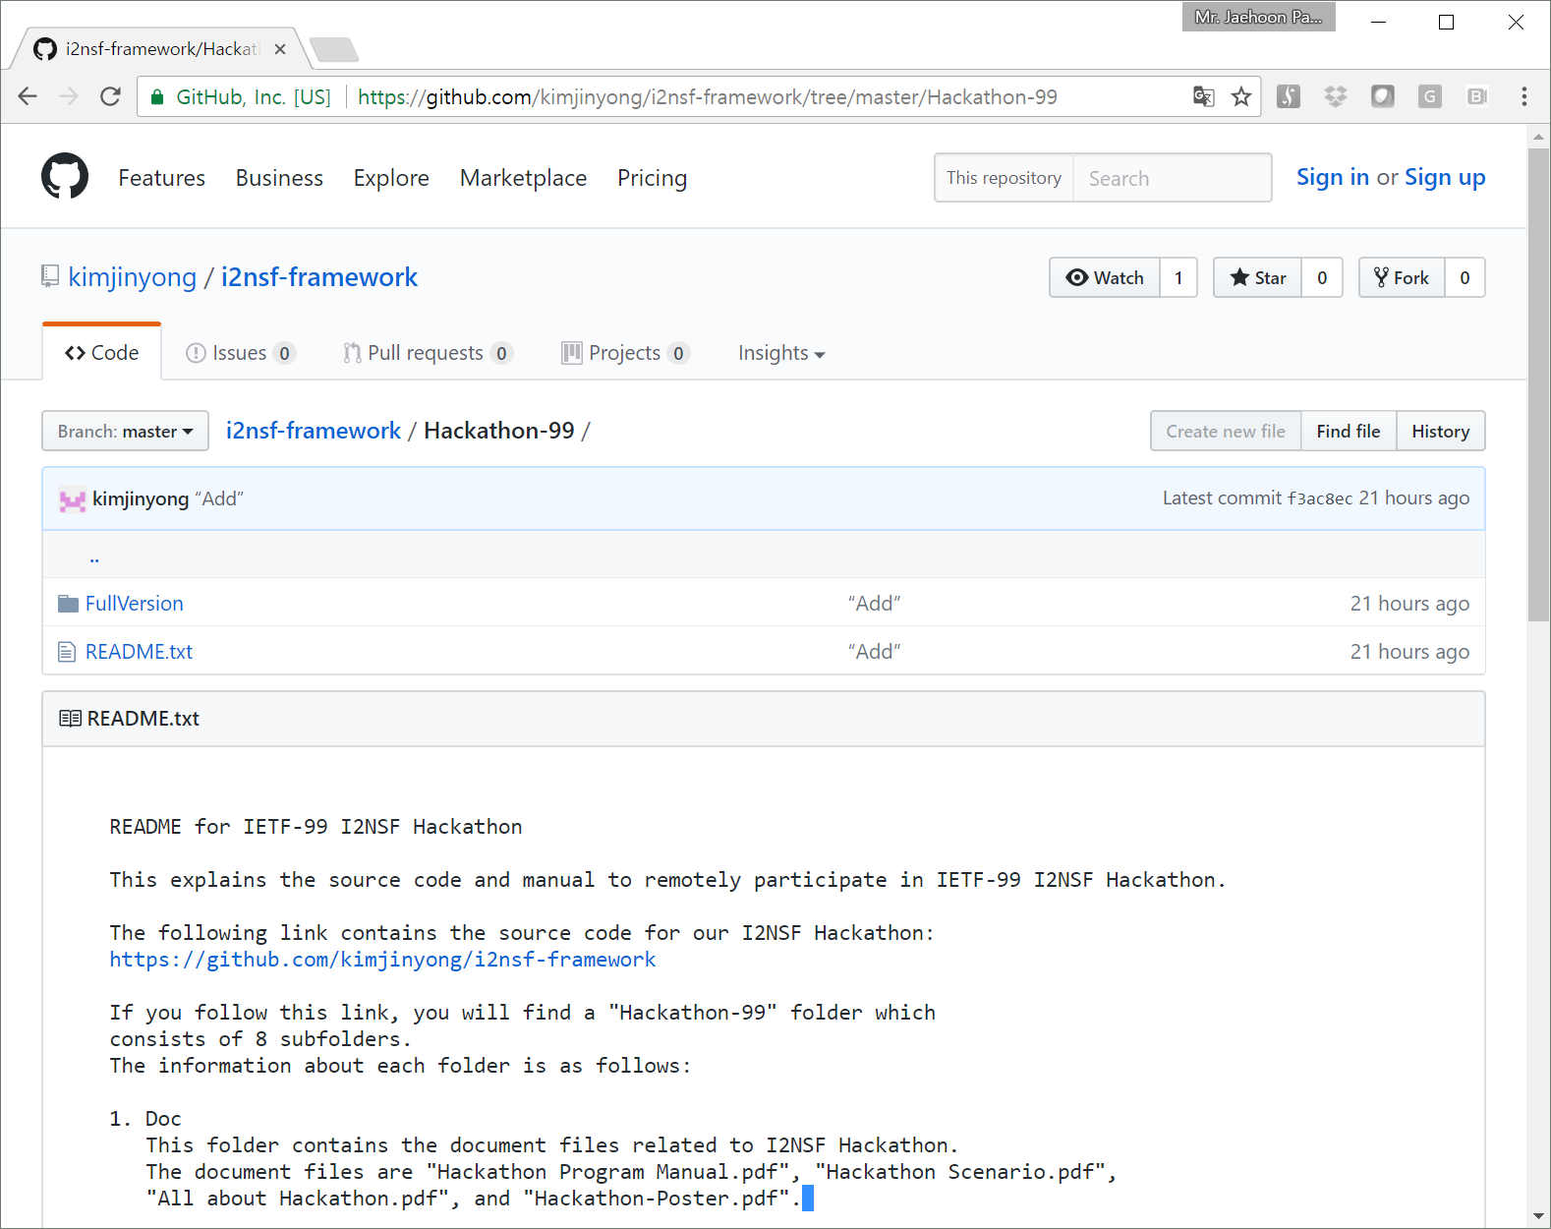
Github Code of I2NSF Implementation
https://github.com/kimjinyong/i2nsf-framework/tree/master/ Hackathon-101

